Slide 1
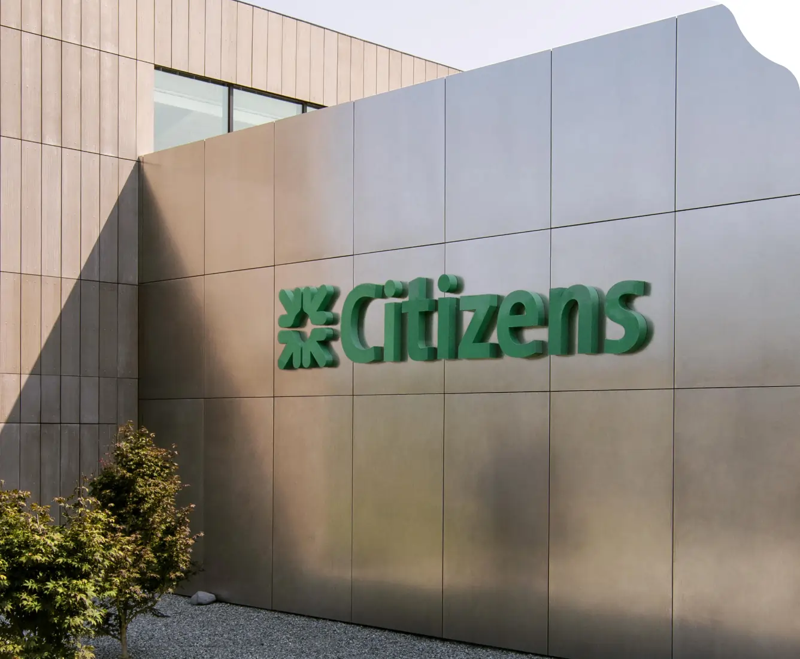
Company Profile
Citizens Financial Group, Inc.
Prepared by AH

Slide 2
TABLE OF CONTENTS
1
COMPANY OVERVIEW
3
2
FINANCIAL SNAPSHOT
6
3
BUSINESS SEGMENTS
7
4
EXECUTIVE LEADERSHIP
12
5
IT STRATEGIES, INVESTMENTS, AND INITIATIVES
14
6
BUSINESS UPDATES AND NEWS
18
7
STRATEGIC VISION AND ROADMAP
21

Slide 3

COMPANY OVERVIEW

Slide 4








COMPANY OVERVIEW
Company Outline
Citizens Financial Group, Inc., headquartered in Providence, Rhode Island, is one of the oldest and largest financial institutions in the United States, with total assets reaching $222.2 billion as of June 30, 2024.
Citizens is dedicated to helping its customers achieve their financial goals by listening to their needs and providing personalized advice, solutions, and ideas.
The company offers a wide range of banking products and services for individuals, small businesses, middle-market companies, large corporations, and institutions.
In Consumer Banking, Citizens delivers an integrated experience through mobile and online banking, a full-service customer contact center, and access to around 3,300 ATMs and more than 1,100 branches across 14 states and the District of Columbia.
Additionally, the company operates 105 retail and commercial non-branch offices, with certain services available nationwide. Consumer Banking includes a variety of services, such as personal banking, lending, savings, wealth management, and small business offerings.
In Commercial Banking, Citizens provides a comprehensive suite of financial products and services, including lending and leasing, deposit and treasury management, foreign exchange, risk management solutions for interest rates and commodities, as well as loan syndication, corporate finance, M&A advisory, and debt and equity capital markets expertise.
Founded Year: 1828
Headquarters: United States
Employees: 17,570 (2023)
Traded As: CFG (NYSE)
Total Assets: $222.2 Billion
Deposits: $177.3 Billion
Branches: ~1,100
ATMs: ~3,300
Source: Annual Report, Company Website

Slide 5
FINANCIAL SNAPSHOT

Slide 6
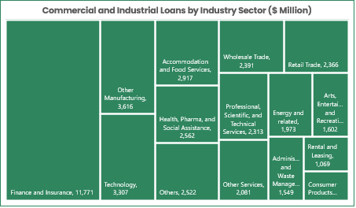
FINANCIAL SNAPSHOT
Citizens Financial
At A Glance
$8,330 Million
$5,254 Million
$3,076 Million
$43,826 Million
Total Revenue (2023)
Consumer Banking Revenue (2023)
Commercial Banking Revenue (2023)
Total Commercial and Industrial Loan
Source: Annual Report, Investor Relations

Slide 7
BUSINESS SEGMENTS

Slide 8
BUSINESS SEGMENTS (1/4)
BUSINESS SEGMENTS SNAPSHOT
Citizens Financial Group, Inc.
Personal/Consumer
Business/Commercial
Corporate Banking
Private Bank
Checking Accounts
Banking & Credit Cards
Financing
Personal Banking
Savings Accounts
Borrowing & Financing
Capital Markets & Advisory
Wealth Management
Credit Cards
Managing Cash Flow
Risk Management
Banking for Your Business
Home Loans
Investing & Benefits
Treasury Management
Student Loans
Point of Sale Financing
Credit Card & Payment Services
Financial Education
Business Resources
Investing & Wealth Management

Slide 9

BUSINESS SEGMENTS (2/4)
PERSONAL/CONSUMER BANKING
Checking Accounts
Personal/Consumer Banking serves consumer customers and small businesses with annual revenues of up to $25 million, offering a range of products and services such as deposits, mortgage and home equity loans, credit cards, small business loans, and wealth management and investment services, largely across our 14-state banking network.
Additionally, Citizens provides education and point-of-sale financing loans, along with select digital deposit products available nationwide.
Consumer Banking operates through a multi-channel distribution network that includes approximately 5,300 branch employees, 1,100 branches (including 187 in-store locations), and around 3,300 ATMs. The network also consists of roughly 1,100 specialists who cover lending, savings, investment needs, and a wide array of small business products and services.
01
Financial Education
Savings Accounts
07
02
Investing & Wealth Management
06
03
Credit Cards
05
04
Student Loans
Home Loans
Savings Accounts
Citizens Financial Group, Inc. offers a wide range of financial products and services to meet the diverse needs of its customers. For savings, the bank provides options such as traditional savings accounts, money market accounts, certificates of deposit (CDs), and IRA savings and CDs.
In home lending, Citizens offers mortgages, home loans, mortgage refinancing, new construction loans, and home equity lines of credit.
The bank also supports customers with financial education resources, covering topics like managing finances, college planning, homeownership, financial planning, and small business guidance.
Additionally, Citizens offers various student loan products, including loans for undergraduates, graduates, and parents, as well as refinancing options for students, medical residents, and parents, along with scholarships.
Savings Accounts
Money Market Accounts
Certificates of Deposit (CDs)
IRA Savings & CDs
Student Loans
Financial Education
Undergraduate Student Loans
Graduate Student Loans
Parent Loans
Refinancing for Students
Refinancing for Medical Residents
Refinancing for Parents
Scholarship
Managing Finances
College
Home Ownership
Financial Planning
Small Business
Home Loans
Mortgages & Home Loans
Refinance a Mortgage
New Construction Loans
Home Equity Line of Credit
Source: Company Website

Slide 10






BUSINESS SEGMENTS (3/4)
BUSINESS/COMMERCIAL BANKING
Investing & Benefits
Banking & Credit Cards
Commercial Banking primarily serves companies and institutions with annual revenues of $25 million to more than $3.0 billion and strives to be a trusted advisor to our clients and preferred provider for their banking needs.
Citizen offers a broad complement of financial products and solutions, including lending and leasing, deposit and treasury management services, foreign exchange, interest rate and commodity risk management solutions, as well as syndicated loans, corporate finance, mergers and acquisitions, and debt and equity capital markets capabilities.
Commercial Banking at Citizens is structured to address the unique needs of different client segments. The bank provides a range of financial solutions, including deposit services, money movement, borrowing options, and credit facilities, to support businesses at every stage of growth.
Point of Sale Financing
Borrowing & Financing
Business Resources
Managing Cash Flow
Additionally, Citizens' Business Learning Resource Center offers valuable guidance to help clients navigate key milestones, such as starting a business, scaling operations, and improving efficiencies as their business grows.
For banking and credit cards, the bank provides business checking accounts, nonprofit checking, and business overdraft protection options, along with savings accounts, money market accounts, and CDs. Businesses can also take advantage of business credit cards, online and mobile banking services, specialized checking options, and the necessary account documentation.
In terms of borrowing and financing, Citizens offers a variety of business lending solutions, including business credit cards and Small Business Administration loans, as well as Paycheck Protection Program loan forgiveness services to help businesses recover from the pandemic. To help businesses manage their cash flow, the bank provides cash management services, payroll solutions, & merchant services for efficient payment processing.
Banking & Credit Cards
Managing Cash Flow
Business Checking
Nonprofit Checking
Business Overdraft Choices
Business Savings, Money Markets and CDs
Business Credit Cards
Business Online & Mobile Banking
Specialized Checking
Account Documents
Cash Management
Payroll Services
Merchant Services
Borrowing & Financing
Business Lending
Business Credit Cards
Small Business Administration (SBA) Loan
Paycheck Protection Program Loan Forgiveness
Investing & Benefits
Employee Benefits Solutions
Investment Management
Insurance Protection
Source: Company Website

Slide 11








BUSINESS SEGMENTS (4/4)
CORPORATE BANKING
PRIVATE BANKING
Corporate Banking serves commercial and industrial clients with annual revenues ranging from $25 million to $500 million, as well as corporate clients with revenues between $500 million and over $3.0 billion across the United States.
Citizens acquires new clients through a strategic, coordinated market approach, utilizing in-depth industry expertise within specialized banking groups and a geographically targeted coverage model.
In industries such as Aerospace, Defense and Government Services, Communications, Transportation and Logistics, Food and Restaurants, Human Capital Management, Industrial, Technology, Healthcare, and Gaming, Citizens offers a more specialized and customized approach to better address the unique needs of these client segments.
Citizens Private Banking is designed to simplify customers' financial journeys and help them and their families maximize their wealth. As a client of Citizens Private Bank, customers will have a dedicated Relationship Manager who is committed to understanding their needs and delivering personalized, comprehensive banking and wealth management solutions tailored to exceed expectations.
Whether customers need to simplify complex financial situations or secure long-term success for future generations, Citizens provides exceptional solutions and outstanding service across a broad range of sectors, including Individuals & Families, Private Equity & Venture Capital, Innovation Banking, Professional Services, Commercial Real Estate, and Nonprofits & Private Foundations.
Individuals & Families
Financing
Personal Banking
Private Equity & Venture Capital
01
Capital Markets & Advisory
02
Innovation Banking
03
Banking for Your Business
Services
Area of Focus
Risk Management
Professional Services
Treasury Management
04
05
Private Wealth Management
Commercial Real Estate
Credit Card & Payment Services
Nonprofits & Private Foundations
Source: Company Website

Slide 12
EXECUTIVE LEADERSHIP

Slide 13









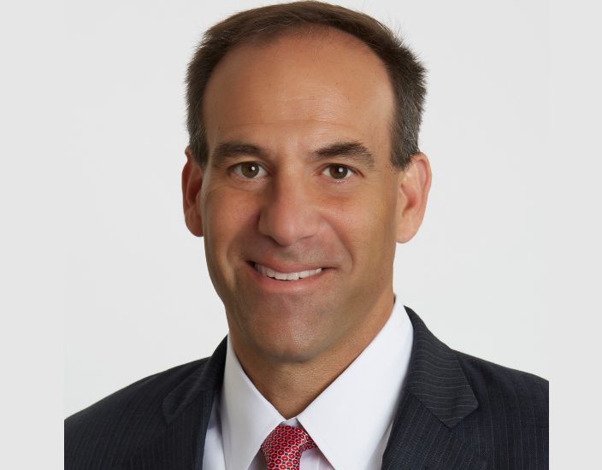
EXECUTIVE LEADERSHIP
Bruce Van Saun
Chairman and CEO
Donald H. McCree
John F. Woods
Beth Johnson
Brendan Coughlin
Senior Vice Chair and Head of Commercial Banking
Vice Chair and Chief Financial Officer
Vice Chair and Chief Experience Officer
Vice Chair and Head of Consumer Banking
Polly Klane
Michael Ruttledge
Richard Stein
Susan LaMonica
Ted Swimmer
Chief Legal Officer and General Counsel
Chief Information Officer and Head of Technology Services
Chief Risk Officer
Chief Human Resources Officer
Head of Capital Markets & Advisory
Source: Company Website

Slide 14
IT STRATEGIES, INVESTMENTS, AND INITIATIVES

Slide 15




IT STRATEGIES, INVESTMENTS AND INITIATIVES (1/3)
IT STRATEGIES
Citizens Bank’s IT strategies play a critical role in driving the growth and transformation of its business. The bank is working to become a digital-first financial institution that meets evolving customer needs by investing in advanced technologies such as cloud computing, AI, cybersecurity, big data analytics, and automation.
With a constant focus on refining its IT approach, Citizens is leveraging strategic partnerships with technology, cloud, and fintech providers to enhance customer experience, improve operational efficiency, and embrace emerging technologies—key factors in sustaining long-term growth.
Cloud Transformation & Microservices Architecture
Modernizing IT infrastructure to enhance scalability, flexibility, and operational efficiency.
Shifting to a cloud-based environment to better meet customer demands, streamline operations, and introduce more innovative digital products.
Adopting microservices architecture to boost agility in software development and enable faster deployment of new applications and services
Cybersecurity & Digital Identity Solutions
Deploying a multi-layered security framework to safeguard sensitive customer data and secure online transactions.
Partnering with cybersecurity providers to integrate advanced authentication and fraud prevention tools into digital services, enhancing security and mitigating fraud risks.
Ongoing monitoring and real-time threat detection to quickly identify and address potential security vulnerabilities.
Partnership And Fintech Collaboration
Collaborating with fintech and tech companies to seamlessly integrate innovative solutions into its existing infrastructure, avoiding the need to develop everything internally.
Expanding its offerings in digital payments, cryptocurrency, block-chain, and other emerging financial technologies to stay ahead.
Strengthening data analytics capabilities, enabling better decision-making, deeper customer insights, and improved operational efficiency.
Automation & Artificial Intelligence
Leveraging automation and AI across multiple business functions to improve operational efficiency and reduce costs.
Automating repetitive tasks, such as loan approvals, customer service inquiries, and back-office processes, to streamline operations.
Personalizing financial advice and services by analyzing customer behavior and preferences.
Utilizing AI-powered chatbots and virtual assistants to handle real-time customer inquiries.

Slide 16





IT STRATEGIES, INVESTMENTS AND INITIATIVES (2/3)
Mobile Banking
Citizens offers a comprehensive mobile banking app that provides convenient and secure access to account information, payments, transfers, and other banking services.
Online Banking
Citizens' online banking platform enables customers to manage their finances, pay bills, transfer funds, and access various financial tools, all from the convenience of their computer or mobile device.
Virtual Assistants
Citizens is integrating virtual assistants into its customer service channels, providing quick and efficient support through automated responses and personalized interactions.
Data Analytics
Citizens is leveraging data analytics to gain insights into customer behavior, improve risk management, and personalize product offerings, enabling the bank to make informed decisions and enhance its services.
Digital Transformation
Here are some of the recent strategic developments:
Month & Year | Description
June 2024 | Citizens Bank partnered with MongoDB, Inc. and Amazon Web Services (AWS) to build a modern technology stack with a microservices-based architecture, cutting costs by $1.5 million annually and streamlining operations.
October 2023 | Citizens Bank selected the nCino Cloud Banking Platform, including its Commercial Banking, Portfolio Analytics, and Mortgage Solutions, to improve internal processes and enhance client services.
January 2023 | Citizens teamed up with Mastercard Inc. (U.S.) to provide advanced authentication and fraud prevention tools, leveraging Mastercard's digital identity solutions for both consumer and business customers.
March 2022 | Citizens broadened its partnership with FIS, enabling Worldpay from FIS (U.S.) to process Card-to-Crypto transactions for top digital asset companies, including crypto exchanges, wallets, and brokers, across the United States.
Source: Press Releases, Newsroom, Company Website

Slide 17
IT STRATEGIES, INVESTMENTS AND INITIATIVES (3/3)
INVESTMENTS AND INITIATIVES
Month & Year | Approach | Description
September 2024 | Initiative/ Investment | Citizens committed $10 million over two years to support workforce development, aiming to strengthen talent pipelines and boost economic growth across its footprint.
June 2024 | Initiative | Citizens awarded its Small Business Community Champions a one-year Luminary Fellowship, providing access to a global professional education and networking platform supporting entrepreneurs at all stages.
June 2024 | Initiative | Citizens named seven nonprofits as its 2024 Champions in Action, each receiving $50,000 in funding and support to help prepare youth and workers for in-demand digital and tech jobs.
March 2024 | Initiative | Citizens granted $2.4 million in financial empowerment grants to 137 nonprofits, including $415,000 to Junior Achievement for its "Citizens Helping Citizens Manage Money" program, supporting efforts from the Teen Financial Health Survey.
March 2024 | Initiative | Citizens extended its partnership with The Andy Warhol Museum, granting $200,000 to The Warhol Academy to support economic mobility and workforce development in Pittsburgh's arts and culture sector.
February 2024 | Initiative | Citizens selected seven nonprofits as its 2024 Champions in Action, each receiving $50,000 in funding, along with promotional and volunteer support, to boost energy efficiency or expand access to clean energy in their communities.
October 2023 | Initiative | Citizens announced a $200,000 grant to the Pittsburgh Film Office to support the growth and expansion of the film industry across the 10 counties of Southwestern Pennsylvania.
May 2023 | Investment | Citizens invested an additional $400,000 in the Education Design Lab’s Community College Growth Engine, with $100,000 each for four CUNY colleges—LaGuardia, Borough of Manhattan, Kingsborough, and Queensborough—to support their growth.
March 2023 | Investment | Citizens committed $340,000 through its Charitable and Philanthropic Foundations to support workforce development, including technical training and career counseling, across New Jersey.
Source: Press Releases, Newsroom, Company Website

Slide 18
BUSINESS UPDATES AND NEWS

Slide 19
BUSINESS UPDATES AND NEWS (1/2)
RECENT BUSINESS UPDATES AND NEWS
Month & Year | Approach | Description
October 2024 | Expansion | Citizens announced the next phase of its West Coast expansion, adding a top Private Banking team in Southern California (SoCal) and planning new office openings in the region.
September 2024 | Partnership | Citizens partnered with Navan Expense (U.S.) to offer a holistic travel management platform for Citizens’ clients.
May 2024 | New Product Launches | Citizens launched a Cash Flow Forecasting Solution for business banking customers, offering insights, tips, and benchmarking to compare businesses by location, revenue, and size.
May 2024 | Partnership | Citizens partnered with Style Crest Enterprises (Canada) to refinance debt and support acquisitions with a $105 million credit facility, including a $75 million term loan and a $30 million revolving line of credit.
February 2024 | Expansion | Citizens accelerated its wealth management business with leadership hires and a new Private Banking office in Boston, plus planned openings in Palm Beach and Mill Valley in 2024.
December 2023 | Partnership | Citizens partnered with Credit Acceptance Corporation (U.S.), an indirect auto finance program provider to implement real-time payments in order to meet the 24/7 demand.
December 2023 | New Product Launches | Citizens in a collaborative partnership with Mastercard Inc. (U.S.) introduced the new Mastercard Debit and ATM Card from Citizens Bank, N.A., featuring sustainable manufacturing and touch card functionality.
November 2023 | New Product Launches | Citizens launched Citizens Cash Flow Essentials, an all-in-one cash management platform with Digital Invoicing, to help small businesses manage cash flow securely via online banking.
October 2023 | New Product Launches | Citizens launched digital account opening for business banking customers, allowing them to open sole proprietorship deposit accounts through a new self-service online channel.
September 2023 | Partnership | Citizens partnered with Trek Bicycle Corporation (U.S.) to provide cycling enthusiasts with flexible payment and financing solutions through Citizens Pay.

Slide 20
BUSINESS UPDATES AND NEWS (2/2)
Month & Year | Approach | Description
August 2023 | Partnership | Citizens partnered with Wyndham Destinations (U.S.) to offer flexible down payment financing through Citizens Pay, allowing consumers to explore their favorite resort destinations.
June 2023 | Partnership | Citizens partnered with The Tile Shop to offer flexible financing options for home design projects through Citizens Pay.
February 2023 | New Product Launches | Citizens launched Zelle within its mobile banking app for eligible small business customers, enabling them to send and receive payments quickly and easily.
January 2023 | Partnership | Citizens partnered with Mastercard Inc. (U.S.) to serve as their exclusive payments provider for all product portfolios.
October 2023 | New Product Launches | Citizens launched Citizens Private Bank nationally to drive growth in Wealth Management, enhance services for high-net-worth clients, and expand in key markets.
October 2023 | New Product Launches | Citizens introduced its Carbon Offset Deposit Account solution, offering corporate clients an additional tool to support their ESG goals, alongside its Green Deposits solution.
February 2022 | Acquisition | Citizens acquired 80 East Coast branches and HSBC’s national online deposit business, expanding its footprint and adding 800,000+ new customer accounts to boost its national growth strategy.
September 2021 | New Product Launches | Citizens introduced its Integrated Payables solution, featuring invoice automation, which allows companies to streamline the entire invoice-to-pay process on a single platform.
August 2021 | Acquisition | Citizens signed a definitive agreement to acquire Willamette Management Associates (U.S.), enhancing its corporate financial advisory services and positioning the bank among the top valuation providers in the country.
July 2021 | Acquisition | Citizens signed a definitive agreement to merge with Investors Bancorp, Inc. (U.S.), expanding its Northeast presence, adding one million customers, and boosting growth potential.
July 2021 | Partnership | Citizens partnered with PrimaHealth Credit to offer a pioneering financing solution, enabling healthcare providers to serve patients across the credit spectrum with a comprehensive patient financing option.
Source: Press Releases, Newsroom, Company Website

Slide 21
STRATEGIC VISION AND ROADMAP

Slide 22

STRATEGIC VISION AND ROADMAP (1/3)
STRATEGIC VISION AND ROADMAP
Enhancing Customer Experience
Strengthening Security and Risk Management
Citizens is experiencing a transformative journey, positioning itself as a prominent, customer-focused digital bank with a commitment to long-term growth, operational efficiency, and innovation.
Its strategic vision and roadmap highlight efforts to modernize operations, enhance technology, expand market presence, and create value for customers and stakeholders.
The roadmap is centered around key pillars such as digital transformation, security and risk management, customer experience, operational efficiency, growth strategy, and sustainability.
02
04
01
05
03
Growth and Expansion
Commitment to Sustainability and Corporate Responsibility
Digital Transformation & Technological Advancements
Growth and Expansion
Citizens is focused on expanding its geographic presence and broadening its service offerings to tap into new market opportunities. The bank is working to grow its commercial banking, consumer banking, and wealth management businesses, while making strategic investments in technology and innovation.
As part of its growth strategy, Citizens is also enhancing its wealth management division. The bank is opening new private banking offices in key regions to increase market share, target high-growth areas, and diversify its product offerings.
For instance, in June 2023, Citizens significantly advanced its private banking growth strategy by adding around 50 senior private bankers and support staff across key markets, including Boston, Florida, New York, and San Francisco. This expansion strengthens Citizens' ability to grow its wealth management services, scale business banking, increase deposits, and bolster its presence in critical growth markets.
As part of its expansion strategy, Citizens has pursued key acquisitions. For instance, in February 2022, Citizens acquired 80 East Coast branches and the national online deposit business from HSBC Bank U.S.A., N.A., expanding its physical footprint into several key markets and adding over 800,000 new customer accounts, further advancing the bank's national growth strategy.

Slide 23


STRATEGIC VISION AND ROADMAP (2/3)
Enhancing Customer Experience
Citizens is placing a strong emphasis on improving customer experience by offering personalized solutions, innovative products, and a seamless digital interface. The bank is making significant investments in technologies that foster customer engagement and loyalty to meet evolving expectations.
By leveraging AI and big data, Citizens is able to provide tailored financial products that align with individual customer preferences. A key component of the bank’s roadmap is the continued enhancement of its digital banking capabilities.
For instance, in October 2023, Citizens launched digital account opening for business banking customers, allowing them to open sole proprietorship deposit accounts through a new self-service online channel.
Digital Transformation & Technological Advancements
Citizens is transitioning to a digital-first bank, leveraging cutting-edge technology to improve scalability, flexibility, and deliver innovative financial solutions that meet the evolving needs of customers.
A key element of Citizens' roadmap is its transition to a cloud-based infrastructure. The shift to the cloud is designed to boost scalability, reduce operational costs, and accelerate the deployment of new digital products and services, while enhancing Citizens' ability to meet growing customer demands with more agile, flexible, and cost-efficient operations.
Citizens Bank plans to take its banking operations to the cloud by 2025.
Automation and AI play a key role in Citizens' roadmap, driving improvements across various business functions. These technologies automate routine tasks such as loan approvals and customer service inquiries, while also leveraging AI for predictive analytics and fraud detection.

Slide 24


STRATEGIC VISION AND ROADMAP (3/3)
Strengthening Security and Risk Management
Citizens is making significant investments in cybersecurity infrastructure to safeguard against evolving threats and uphold customer trust, recognizing that in an increasingly digital world, securing customer data and financial transactions is critical.
Citizens incorporates advanced authentication tools, including biometric verification and secure online transaction systems, to mitigate cyber threats. The bank also uses multi-layered security measures to protect customer information and prevent fraud. Additionally, it employs real-time threat monitoring and fraud detection systems to quickly identify and address potential risks.
Citizens also collaborates with cybersecurity providers to incorporate advanced authentication and fraud prevention tools into its digital services, strengthening security and reducing fraud risks.
Commitment to Sustainability and Corporate Responsibility
Citizens is strongly dedicated to environmental sustainability and corporate social responsibility (CSR). The bank's roadmap outlines specific sustainability goals and initiatives that align with global standards, supporting long-term, sustainable growth.
Citizens has set targets to reduce its Scope 1 and 2 greenhouse gas (GHG) emissions by 30% by 2025 and 50% by 2035, based on 2016 levels, in support of global efforts to limit temperature rise. These goals align with the Paris Agreement’s objective to keep the global temperature increase well below 2°C above pre-industrial levels.
Citizens is also committed to fostering a more sustainable future by financing and supporting environmental and social initiatives. The bank has set a $50 billion Sustainable Finance Target by 2030, including $5 billion in green financing. The company will also engage corporate clients in high-emitting sectors on climate issues, starting with 100% of its Oil & Gas clients by the end of 2024. Additionally, Citizens has committed to achieving carbon neutrality by 2035.
In addition, Citizens is working towards a more sustainable future in collaboration with its customers, employees, shareholders, and communities. For instance, in September 2022, Citizens signed a power purchase agreement with Ørsted A/S to support the Sunflower Wind Project. This initiative will provide renewable energy credits (RECs) to offset 100% of Citizens' power consumption across its entire operations, ensuring the use of 100% renewable energy.

Slide 25
THANK YOU

